Slide 1
Cryptography and Network Security
Other Public Key Cryptosystems
Notes:
Lecture slides by Lawrie Brown for “Cryptography and Network Security”, 5/e, by William Stallings, Chapter 10 – “Other Public Key Cryptosystems”.

Slide 2
Key Management
Public-key encryption helps address key distribution problems
Distribution of public keys
Use of public-key encryption to distribute secret keys

Slide 3
Distribution of Public Keys
Can be considered as using one of:
  Public announcement
  Publicly available directory
  Public-key authority
  Public-key certificates

Slide 4
Public Announcement
Users distribute public keys to recipients or broadcast to community at large
  Eg. Append PGP keys to email messages or post to news groups or email list
Major weakness is forgery
  Anyone can create a key claiming to be someone else and broadcast it
  Until forgery is discovered can masquerade as claimed user for authentication

Slide 5
Publicly Available Directory
Can obtain greater security by registering keys with a public directory
Directory must be trusted with properties:
  Contains {name, public-key} entries
  Participants register securely with directory
  Participants can replace key at any time
  Directory is periodically published
  Directory can be accessed electronically
Still vulnerable to tampering or forgery

Slide 6
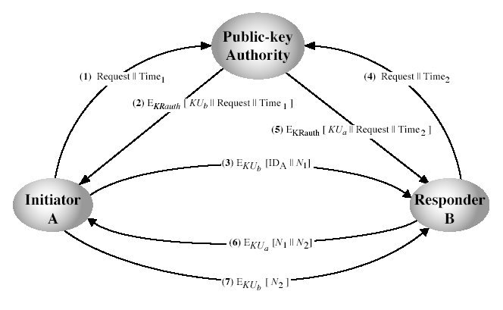
Public-Key Authority
Notes:
Stallings Fig 10-3. See text for details of steps in protocol.

Slide 7
Public-Key Authority
Improve security by tightening control over distribution of keys from directory
Requires users to know public key for the directory
Then users interact with directory to obtain any desired public key securely
  Does require real-time access to directory when keys are needed

Slide 8
Public-Key Certificates
The public-key authority could be a bottleneck in the system.
  Must appeal to the authority for the key of every other user
Certificates allow key exchange without real-time access to public-key authority
A certificate binds identity to public key
With all contents signed by a trusted public-key or certificate authority (CA)
  Certifies the identity
  Only the CA can make the certificates

Slide 9
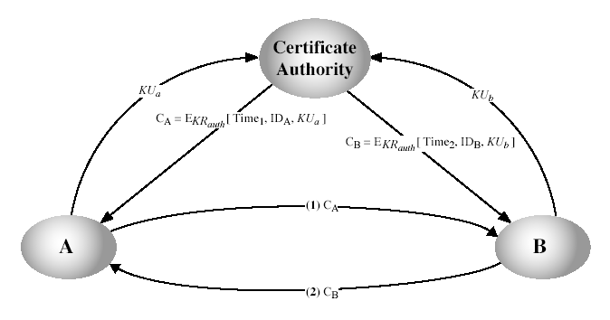
Public-Key Certificates
Notes:
Stallings Fig 10-4. See text for details of steps in protocol.

Slide 10
Public-Key Distribution of Secret Keys
Public-key algorithms are slow
So usually want to use private-key encryption to protect message contents
Hence need a session key
Have several alternatives for negotiating a suitable session using public-key

Slide 11
Simple Secret Key Distribution
Proposed by Merkle in 1979
  A generates a new temporary public key pair
  A sends B the public key and their identity
  B generates a session key K sends it to A encrypted using the supplied public key
  A decrypts the session key and both use
Problem is that an opponent can intercept and impersonate both halves of protocol

Slide 12
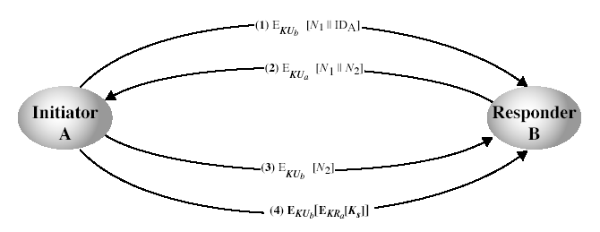
Public-Key Distribution of Secret Keys
First securely exchanged public-keys using a previous method
Notes:
Stallings Fig 10-6. See text for details of steps in protocol. Note that these steps correspond to final 3 of Fig 10.3, hence can get both secret key exchange and authentication in a single protocol.

Slide 13
Diffie-Hellman Key Exchange
First public-key type scheme proposed
Two parties can carry on a public conversation, and still end up with a secret that only the two of them know!
Public secret sharing
Shared secret is derived from private secrets and publically shared information
Notes:
This chapter continues our overview of public-key cryptography systems (PKCSs), and begins with a description of one of the earliest and simplest PKCS, Diffie-Hellman key exchange. This first published public-key algorithm appeared in the seminal paper by Diffie and Hellman that defined public-key cryptography [DIFF76b] and is generally referred to as Diffie-Hellman key exchange. The concept had been previously described in a classified report in 1970 by Williamson (UK CESG) - and subsequently declassified in 1987, see [ELLI99]. The purpose of the algorithm is to enable two users to securely exchange a key that can then be used for subsequent encryption of messages. The algorithm itself is limited to the exchange of secret values. A number of commercial products employ this key exchange technique.

Slide 14
Diffie-Hellman Key Exchange
First public-key type scheme proposed
By Diffie & Hellman in 1976 along with the exposition of public key concepts
Is a practical method for public exchange of a secret key – in practice, a “pre-key”
Used in a number of commercial products
Notes:
This chapter continues our overview of public-key cryptography systems (PKCSs), and begins with a description of one of the earliest and simplest PKCS, Diffie-Hellman key exchange. This first published public-key algorithm appeared in the seminal paper by Diffie and Hellman that defined public-key cryptography [DIFF76b] and is generally referred to as Diffie-Hellman key exchange. The concept had been previously described in a classified report in 1970 by Williamson (UK CESG) - and subsequently declassified in 1987, see [ELLI99]. The purpose of the algorithm is to enable two users to securely exchange a key that can then be used for subsequent encryption of messages. The algorithm itself is limited to the exchange of secret values. A number of commercial products employ this key exchange technique.

Slide 15
Diffie-Hellman Key Exchange
A public-key distribution scheme
  Cannot be used to exchange an arbitrary message
  Rather it can establish a common key
  Known only to the two participants
Value of key depends on the participants (and their private and public key information)
Notes:
The purpose of the algorithm is to enable two users to securely exchange a key that can then be used for subsequent encryption of messages. The algorithm itself is limited to the exchange of secret values, which depends on the value of the public/private keys of the participants. The Diffie-Hellman algorithm uses exponentiation in a finite (Galois) field (modulo a prime or a polynomial), and depends for its effectiveness on the difficulty of computing discrete logarithms.

Slide 16
Diffie-Hellman Key Exchange
Derivation of shared secret is based on exponentiation in a finite (galois) field (modulo a prime or a polynomial)
- easy
Security relies on the difficulty of working backward to get secrets by computing discrete logarithms (similar to factoring)
– hard
Notes:
The purpose of the algorithm is to enable two users to securely exchange a key that can then be used for subsequent encryption of messages. The algorithm itself is limited to the exchange of secret values, which depends on the value of the public/private keys of the participants. The Diffie-Hellman algorithm uses exponentiation in a finite (Galois) field (modulo a prime or a polynomial), and depends for its effectiveness on the difficulty of computing discrete logarithms.

Slide 17
Diffie-Hellman Setup
All users agree on global parameters:
  Large prime integer or polynomial q
  a, which is a primitive root mod q
Each user (e.g. A) generates their key
  Chooses a secret key (number): x_{a} < q
  Computes their public key: y_{a} = a^{xa} mod q
Each user makes public that key y_{a}
Notes:
In the Diffie-Hellman key exchange algorithm, there are two publicly known numbers: a prime number q and an integer a that is a primitive root of q. The prime q and primitive root a can be common to all using some instance of the D-H scheme. Note that the primitive root a is a number whose powers successively generate all the elements mod q. Users Alice and Bob choose random secrets x's, and then "protect" them using exponentiation to create their public y's. For an attacker monitoring the exchange of the y's to recover either of the x's, they'd need to solve the discrete logarithm problem, which is hard.

Slide 18
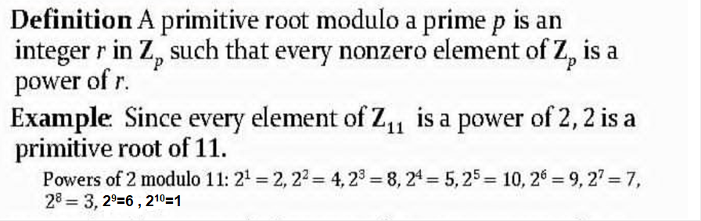
Primitive Root

Slide 19
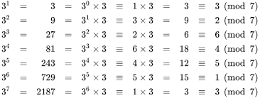
The period of 3^{k} modulo 7 is 6.
The remainders in the period, which are 3, 2, 6, 4, 5, 1, form a rearrangement of all nonzero remainders modulo 7, implying that 3 is indeed a primitive root modulo 7.
This derives from the fact that a sequence (a^{k} modulo n) always repeats after some value of k, since modulo n produces a finite number of values.
If a is a primitive root modulo n and n is prime, then the period of repetition is n − 1

Slide 20
Diffie-Hellman Key Exchange
Shared session key for users A & B is K_{AB}:
  K_{AB} = a^{xa.Xb} mod q
  = Y_{a}^{xb} mod q
  (which B can compute)
  = Y_{b}^{xa} mod q
  (which A can compute)
  Each principal has the other's public key and their own secret, along with a and q.
Notes:
The actual key exchange for either party consists of raising the others "public key' to power of their private key. The resulting number (or as much of as is necessary) is used as the key for a block cipher or other private key scheme. For an attacker to obtain the same value they need at least one of the secret numbers, which means solving a discrete log, which is computationally infeasible given large enough numbers. Note that if Alice and Bob subsequently communicate, they will have the same key as before, unless they choose new public-keys.

Slide 21
Diffie-Hellman Key Exchange
Bob
Alice
Agree on a and q
y_{B} = a^{xB} mod q
y_{A} = a^{xA} mod q
K_{AB} = y_{A}^{xB} mod q
K_{AB} = y_{B}^{xA} mod q
Both Alice and Bob have
K_{AB} = a^{xA.xB} mod q
Notes:
The actual key exchange for either party consists of raising the others "public key' to power of their private key. The resulting number (or as much of as is necessary) is used as the key for a block cipher or other private key scheme. For an attacker to obtain the same value they need at least one of the secret numbers, which means solving a discrete log, which is computationally infeasible given large enough numbers. Note that if Alice and Bob subsequently communicate, they will have the same key as before, unless they choose new public-keys.

Slide 22
Diffie-Hellman Key Exchange
K_{AB} is used as session key (or pre-key) in private-key encryption scheme between alice and bob
If alice and bob subsequently communicate, they will have the same key as before, unless they choose new public-keys (can use nonces and pre-key to make session key different)
Attacker needs a private key x, must solve discrete log base a modulo q to get it
Notes:
The actual key exchange for either party consists of raising the others "public key' to power of their private key. The resulting number (or as much of as is necessary) is used as the key for a block cipher or other private key scheme. For an attacker to obtain the same value they need at least one of the secret numbers, which means solving a discrete log, which is computationally infeasible given large enough numbers. Note that if Alice and Bob subsequently communicate, they will have the same key as before, unless they choose new public-keys.

Slide 23
Diffie-Hellman Example
Users Alice & Bob who wish to swap keys:
Agree on prime q=353 and a=3
Select random secret keys:
  A chooses x_{a}=97, B chooses x_{b}=233
Compute respective public keys:
  Y_{a}=3⁹⁷ mod 353 = 40 (alice)
  Y_{b}=3²³³ mod 353 = 248 (bob)
Compute shared session key as:
  K_{AB}= y_{b}^{xa} mod 353 = 248⁹⁷ = 160 (alice)
  K_{AB}= y_{a}^{xb} mod 353 = 40²³³ = 160 (bob)
Notes:
Here is an example of Diffie-Hellman from the text using prime q=353, showing how each computes its public key, and then how after they exchange public keys, each can compute the common secret key.I n this simple example, it would be possible by brute force to determine the secret key 160. In particular, an attacker E can determine the common key by discovering a solution to the equation 3ª mod 353 = 40 or the equation 3^{b} mod 353 = 248. The brute-force approach is to calculate powers of 3 modulo 353, stopping when the result equals either 40 or 248. The desired answer is reached with the exponent value of 97, which provides 3⁹⁷ mod 353 = 40. With larger numbers, the problem becomes impractical.

Slide 24
Key Exchange Protocols
Users could create random private/public D-H keys each time they communicate
Users could create a known private/public D-H key and publish in a directory, then consult and use them to securely communicate with them
Both of these are vulnerable to a man-in-the-middle attack
Authentication of the keys is needed
Notes:
Now consider a simple protocol that makes use of the Diffie-Hellman calculation. Suppose that user A wishes to set up a connection with user B and use a secret key to encrypt messages on that connection. User A can generate a one-time private key X_{A}, calculate Y_{A}, and send that to user B. User B responds by generating a private value X_{B}, calculating Y_{B}, and sending Y_{B} to user A. Both users can now calculate the key. The necessary public values q and a would need to be known ahead of time. Alternatively, user A could pick values for q and a and include those in the first message.

Slide 25
Man-in-the-Middle Attack
Darth prepares by creating two private / public keys
Alice transmits her public key to Bob
Darth intercepts this and transmits his first public key to Bob. Darth also calculates a shared key with Alice
Bob receives the public key and calculates the shared key (with Darth instead of Alice)
Bob transmits his public key to Alice
Darth intercepts this and transmits his second public key to Alice. Darth calculates a shared key with Bob
Alice receives the key and calculates the shared key (with Darth instead of Bob)
Darth can then intercept, decrypt, re-encrypt, forward all messages between Alice & Bob
Notes:
The protocol described on the previous slide is insecure against a man-in-the-middle attack. Suppose Alice and Bob wish to exchange keys, and Darth is the adversary. The attack proceeds as follows:
Darth prepares for the attack by generating two random private keys X_{D1} and X_{D2} and then computing the corresponding public keys Y_{D1} and Y_{D2}
Alice transmits Y_{A} to Bob.
Darth intercepts Y_{A} and transmits Y_{D1} to Bob. Darth also calculates K2 = (Y_{A} )^ X_{D2} mod q
Bob receives Y_{D1} and calculates K1=(Y_{D1} )^ X_{B} mod q
Bob transmits Y_{B} to Alice.
Darth intercepts Y_{B} and transmits Y_{D2} to Alice. Darth calculates K1=(Y_{B} )^ X_{D1} mod q
Alice receives Y_{D2} and calculates K2=(Y_{D2} )^ X_{A} mod q .
At this point, Bob and Alice think that they share a secret key, but instead Bob and Darth share secret key K1 and Alice and Darth share secret key K2. All future communication between Bob and Alice is compromised in the following way:
Alice sends an encrypted message M: E(K2, M).
Darth intercepts the encrypted message and decrypts it, to recover M.
Darth sends Bob E(K1, M) or E(K1, M'), where M' is any message. In the first case, Darth simply wants to eavesdrop on the communication without altering it. In the second case, Darth wants to modify the message going to Bob. The key exchange protocol is vulnerable to such an attack because it does not authenticate the participants. This vulnerability can be overcome with the use of digital signatures and public- key certificates.

Slide 26
Man-in-the-Middle Attack
Bob
Darth
Alice
y_{A} = a^{xA} mod q
y'_{A} = a^{xDA} mod q
y_{B} = a^{xB} mod q
y'_{B} = a^{xDB} mod q
K_{DAB} = y'_{A}^{xB} mod q
K_{ADB} = y'_{B}^{xA} mod q
Darth has a private, unauthenticated channel with each of Alice and Bob
Notes:
The actual key exchange for either party consists of raising the others "public key' to power of their private key. The resulting number (or as much of as is necessary) is used as the key for a block cipher or other private key scheme. For an attacker to obtain the same value they need at least one of the secret numbers, which means solving a discrete log, which is computationally infeasible given large enough numbers. Note that if Alice and Bob subsequently communicate, they will have the same key as before, unless they choose new public-keys.

Slide 27
Man-in-the-Middle Attack
Also known as “Bucket Brigade” Attack
Need reliable way to associate public key with principal
Public key infrastructure (PKI) is one way
PGP web of trust is another
In some circumstances, may be possible to use scheduling/timing to prevent MITM
Notes:
The protocol described on the previous slide is insecure against a man-in-the-middle attack. Suppose Alice and Bob wish to exchange keys, and Darth is the adversary. The attack proceeds as follows:
Darth prepares for the attack by generating two random private keys X_{D1} and X_{D2} and then computing the corresponding public keys Y_{D1} and Y_{D2}
Alice transmits Y_{A} to Bob.
Darth intercepts Y_{A} and transmits Y_{D1} to Bob. Darth also calculates K2 = (Y_{A} )^ X_{D2} mod q
Bob receives Y_{D1} and calculates K1=(Y_{D1} )^ X_{B} mod q
Bob transmits Y_{B} to Alice.
Darth intercepts Y_{B} and transmits Y_{D2} to Alice. Darth calculates K1=(Y_{B} )^ X_{D1} mod q
Alice receives Y_{D2} and calculates K2=(Y_{D2} )^ X_{A} mod q .
At this point, Bob and Alice think that they share a secret key, but instead Bob and Darth share secret key K1 and Alice and Darth share secret key K2. All future communication between Bob and Alice is compromised in the following way:
Alice sends an encrypted message M: E(K2, M).
Darth intercepts the encrypted message and decrypts it, to recover M.
Darth sends Bob E(K1, M) or E(K1, M'), where M' is any message. In the first case, Darth simply wants to eavesdrop on the communication without altering it. In the second case, Darth wants to modify the message going to Bob. The key exchange protocol is vulnerable to such an attack because it does not authenticate the participants. This vulnerability can be overcome with the use of digital signatures and public- key certificates.

Slide 28
What’s wrong with RSA?
RSA is based upon the ‘belief’ that factoring is ‘difficult’ – never been proven
Prime numbers are getting too large
Amount of research currently devoted to factoring algorithms
Quantum computing will make RSA obsolete overnight

Slide 29
  Elliptic Curve Cryptography
Notes:
Chapter 10 summary.

Slide 30
What exactly is an elliptic curve?
Let a ∈ ℝ, b ∈ ℝ, be constants such that
4a³ + 27b² ≠ 0.
A non-singular elliptic curve is the set E of solutions (x,y) ∈ ℝ x ℝ to the equation:
y² = x³ + ax + b
together with a special point O called the point at infinity.

Slide 31
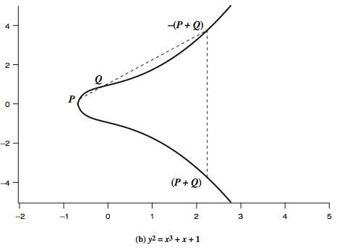
Real Elliptic Curve Example
Notes:
Stallings Figure 10.4b “Example of Elliptic Curves”, illustrates the geometric interpretation of elliptic curve addition, as follows: If three points on an elliptic curve lie on a straight line, their sum is O. hence define addition as:
O serves as the additive identity. Thus O = –O; for any point P on the elliptic curve, P + O = P. In what follows, we assume P <> O and Q <> O.
The negative of a point P is the point with the same x coordinate but the negative of the y coordinate; that is, if P = (x, y), then –P = (x, –y). These two points can be joined by a vertical line & that P + (–P) = P – P = O.
To add two points P and Q with different x coordinates, draw a straight line between them and find the third point of intersection R. There is a unique point R that is the point of intersection (unless the line is tangent to the curve at either P or Q, in which case we take R = P or R = Q, respectively). To form a group structure, we need to define addition on these three points as follows: P + Q = –R. ie. P + Q to be the mirror image (with respect to the x axis) of the third point of intersection as shown on slide.
The geometric interpretation of the preceding item also applies to two points, P and –P, with the same x coordinate. The points are joined by a vertical line, which can be viewed as also intersecting the curve at the infinity point. We therefore have P + (–P) = O, consistent with item (2).
To double a point Q, draw the tangent line and find the other point of intersection S. Then Q + Q = 2Q = –S.
With the preceding list of rules, it can be shown that the set E(a, b) is an abelian group.

Slide 32
Singular Elliptic Curve
If 4a³ + 27b² = 0, then we have a singular elliptic curve
This could potentially lead to having to not having 3 distinct roots
Therefore, we must deal with non-singular elliptic curves with the condition 4a³ + 27b² ≠ 0, in order to assure that we have 3 distinct roots.
This will allow us to establish the fact that the solution set E forms an Abelian group.

Slide 33
What is a Group?
Suppose we have any binary operation, such as addition (+), that is defined for every element in a set G, which is denoted (G, +)
Then G is a group with respect to addition if the following conditions hold:
1.) G is closed under addition: x ∈ G, y ∈ G,
imply x + y ∈ G
2.) + is associative. For all x, y, z, ∈ G,
x + (y + z) = (x + y) + z
3.) G has an identity element e. There is an e in G such that x + e = e + x = x for all x ∈ G.
4.) G contains inverses. For each x ∈ G, there exists y ∈ G, such that x + y = y + x = e.

Slide 34
What is an Abelian Group
An Abelian group contains all the rules of a group, but also must meet the following criteria:
5.) + is commutative. For all x ∈ G, y ∈ G, x + y = y + x.

Slide 35
Finite Elliptic Curves
Elliptic curve cryptography uses curves whose variables & coefficients are finite
have two families commonly used:
  prime curves E_{p}(a,b) defined over Z_{p}
    use integers modulo a prime
    best in software
  binary curves E_{2m}(a,b) defined over GF(2^{n})
    use polynomials with binary coefficients
    best in hardware
Notes:
Elliptic curve cryptography makes use of elliptic curves in which the variables and coefficients are all restricted to elements of a finite field. Two families of elliptic curves are used in cryptographic applications: prime curves over Z_{p} (best for software use), and binary curves over GF(2^{m}) (best for hardware use).
There is no obvious geometric interpretation of elliptic curve arithmetic over finite fields. The algebraic interpretation used for elliptic curve arithmetic over does readily carry over. See text for detailed discussion.

Slide 36
3 Cases for Solutions
Suppose P, Q ∈ E, where P = (x₁,y₁) and Q = (x₂,y₂), we must consider three cases:
1.) x₁ ≠ x₂
2.) x₁ = x₂ and y₁ = - y₂
3.) x₁ = x₂ and y₁ = y₂
These cases must be considered when defining “addition” for our solution set

Slide 37
Defining Addition on E: Case 1
For the case x₁ ≠ x₂, addition is defined as follows:
(x₁,y₁) + (x₂,y₂) = (x₃,y₃) ∈ E where
x₃ = λ² - x₁ - x₂
y₃ = λ(x₁ – x₃) - y₁, and
λ = (y₂ – y₁) / (x₂ – x₁)

Slide 38
Defining Addition on E : Case 2
For the case x₁ = x₂ and y₁ = - y₂ , addition is defined as follows:
(x₁,y₁) + (x₂,y₂) = (x₃,y₃) ∈ E where
(x,y) + (x,-y) = O, the point at infinity

Slide 39
Defining Addition on E : Case 3
For the case x₁ = x₂ and y₁ = y₂, addition is defined as follows:
(x₁,y₁) + (x₂,y₂) = (x₃,y₃) ∈ E where
x₃ = λ² - x₁ - x₂
y₃ = λ(x₁ – x₃) - y₁, and
λ = (3x₁² + a) / 2y₁

Slide 40
Defining the Identity
The point at infinity O, is the identity element. P + O = O + P = P, for all P ∈ E.
From Case 2, and the Identity Element, we now have the existence of inverses
Beyond the scope here to prove that we have commutativity and associativity as well
Therefore the set of solutions E, forms an Abelian group

Slide 41
Elliptic Curves modulo p
Let p > 3 be prime. The elliptic curve y² = x³ + ax + b over ℤ_{p} is the set of solutions (x,y) ∈ ℤ_{p} x ℤ_{p} to the congruence:
        y² ≡ x³ + ax + b (mod p)
where a ∈ ℤ_{p}, b ∈ ℤ_{p}, are constants such that 4a³ + 27b² ≢ 0 (mod p), together with a special point O called the point at infinity.
Solutions still form an Abelian group

Slide 42
So now for an example
Let’s examine the following elliptic curve as an example:
y² = x³ + x + 6 over ℤ₁₁
X | 0 | 1 | 2 | 3 | 4 | 5 | 6 | 7 | 8 | 9 | 10
x³ + x + 6 mod 11 | 6 | 8 | 5 | 3 | 8 | 4 | 8 | 4 | 9 | 7 | 4
Quadratic Residue? | N | N | Y | Y | N | Y | N | Y | Y | N | Y
Y |  |  | 4,7 | 5,6 |  | 2,9 |  | 2,9 | 3,8 |  | 2,9

Slide 43
Generating our group
From the previous chart, and including the point at infinity O, we have a group with 13 points.
Since the O(E) is prime, the group is cyclic.
We can generate the group by choosing any point other then the point at infinity.
Let our generator = α = (2,7)

Slide 44
The Group
We can generate this by using the rules of addition we defined earlier where 2α = α + α
α = (2,7)2α = (5,2)3α = (8,3)
4α = (10,2)5α = (3,6)6α = (7,9)
7α = (7,2)8α = (3,5)9α = (10,9)
10α = (8,8)11α = (5,9)12α = (2,4)

Slide 45
Elliptic Curve Cryptography
ECC addition is analog of modulo multiply
ECC repeated addition is analog of modulo exponentiation
need “hard” problem equiv to discrete log
  Q=kP, where Q,P belong to a prime curve
  is “easy” to compute Q given k,P
  but “hard” to find k given Q,P
  known as the elliptic curve logarithm problem
Certicom example: E₂₃(9,17)
Notes:
Elliptic Curve Cryptography uses addition as an analog of modulo multiply, and repeated addition as an analog of modulo exponentiation. The “hard” problem is the elliptic curve logarithm problem. We give an example taken from the Certicom Web site (www.certicom.com). Consider the group E₂₃(9, 17). This is the group defined by the equation y² mod 23 = (x³ + 9x + 17) mod 23. What is the discrete logarithm k of Q = (4, 5) to the base P = (16, 5)? The brute-force method is to compute multiples of P until Q is found. Thus P = (16, 5); 2P = (20, 20); 3P = (14, 14); 4P = (19, 20); 5P = (13, 10); 6P = (7, 3); 7P = (8, 7); 8P = (12, 17) ; 9P = (4, 5). Because 9P = (4, 5) = Q, the discrete logarithm Q = (4, 5) to the base P = (16, 5) is k = 9. In a real application, k would be so large as to make the brute-force approach infeasible.

Slide 46
ECC Diffie-Hellman
Can do key exchange analogous to D-H
Users select a suitable curve e_{q}(a,b)
Select base point g=(x₁,y₁)
  With large order n s.t. n_{g}=o
A & B select private keys n_{a}<n, n_{b}<n
Compute public keys: p_{a}=n_{a}g, p_{b}=n_{b}g
Compute shared key: k=n_{a}p_{b}, k=n_{b}p_{a}
  Same since k=n_{a}n_{b}g
Attacker would need to find k, hard
Notes:
Illustrate here the elliptic curve analog of Diffie-Hellman key exchange, which is a close analogy given elliptic curve multiplication equates to modulo exponentiation. Key exchange using elliptic curves can be done in the following manner. First pick a large integer q, which is either a prime number p or an integer of the form 2^{m} and elliptic curve parameters a and b for Equation (10.5) or Equation (10.7). This defines the elliptic group of points E_{q}(a, b). Next, pick a base point G = (x₁, y₁) in E_{q}(a, b) whose order is a very large value n. The order n of a point G on an elliptic curve is the smallest positive integer n such that nG = O. So E_{q}(a, b) and G are parameters of the cryptosystem known to all participants. A key exchange between users A and B can then be accomplished as shown. To break this scheme, an attacker would need to be able to compute k given G and kG, which is assumed hard.

Slide 47
ECC Encryption/Decryption
Must first encode any message M as a point on the elliptic curve p_{m}
Select suitable curve & point G as in D-H
Each user chooses private key n_{a}<n
And computes public key p_{a}=n_{a}g
To encrypt p_{m} : c_{m}={kg, p_{m}+kp_{b}}, k random
Decrypt c_{m} compute:
  P_{m}+kp_{b}–n_{b}(kg) = p_{m}+k(n_{b}g)–n_{b}(kg) = p_{m}
Notes:
Several approaches to encryption/decryption using elliptic curves have been analyzed in the literature. This one is an analog of the ElGamal public-key encryption algorithm. The sender must first encode any message M as a point on the elliptic curve P_{m} (there are relatively straightforward techniques for this). Note that the ciphertext is a pair of points on the elliptic curve. The sender masks the message using random k, but also sends along a “clue” allowing the receiver who know the private-key to recover k and hence the message. For an attacker to recover the message, the attacker would have to compute k given G and kG, which is assumed hard.

Slide 48
ECC Security
Relies on elliptic curve logarithm problem
Compared to factoring, can use much smaller key sizes than with RSA, etc.
For equivalent key lengths computations are roughly equivalent
Hence for similar security ECC offers significant computational advantages
Notes:
The security of ECC depends on how difficult it is to determine k given kP and P. This is referred to as the elliptic curve logarithm problem. The fastest known technique for taking the elliptic curve logarithm is known as the Pollard rho method. Compared to factoring integers or polynomials, can use much smaller numbers for equivalent levels of security.

Slide 49
Comparable Key Sizes for Equivalent Security
Symmetric scheme (key size in bits) | ECC-based scheme (size of n in bits) | RSA/DSA (modulus size in bits)
56 | 112 | 512
80 | 160 | 1024
112 | 224 | 2048
128 | 256 | 3072
192 | 384 | 7680
256 | 512 | 15360
Notes:
Stallings Table 10.3 - “ Comparable Key Sizes in Terms of Computational Effort for Cryptanalysis” ompares various algorithms by showing comparable key sizes in terms of computational effort for cryptanalysis. As can be seen, a considerably smaller key size can be used for ECC compared to RSA. Furthermore, for equal key lengths, the computational effort required for ECC and RSA is comparable. Thus, there is a computational advantage to using ECC with a shorter key length than a comparably secure RSA.

Slide 50
Attacks on Public Key Crypto
RSA – progress in factoring
Any – side channel attacks (timing, power)
Any – quantum computing – gimme qubits
  Key length for factoring (RSA)
  Twice key length for ECC
Limited plaintext attacks (any)
  Need to randomize
Other Protocol attacks
Notes:
We noted in Chapter 7 that, because a symmetric block cipher produces an apparently random output, it can serve as the basis of a pseudorandom number generator (PRNG). Similarly, an asymmetric encryption algorithm produces apparently random output and can be used to build a PRNG. Because asymmetric algorithms are typically much slower than symmetric algorithms, asymmetric algorithms are not used to generate open-ended PRNG bit streams. Rather, the asymmetric approach is useful for creating a pseudorandom function (PRF) for generating a short pseudorandom bit sequence. In this section, we examine two PRNG designs based on pseudorandom functions.

Slide 51

Summarize:
Public Crypto systems
RSA
Diffie-Hellman Key Exchange
Elliptic Curve Cryptography
The Federal Office for Information Security (BSI) recommended the use of at least 3000-bit RSA keys as early as 2023.

